Slide 1

Indian Education System
By:- Rituraj Sharma

Slide 2

Overview
Education is a fundamental process that involves acquiring knowledge, skills, and values through teaching and learning. It empowers individuals, shapes societies, and plays a vital role in personal and societal development.

Slide 3

Steps done
01
Data Collection
02
Data Cleaning and preprocessing
03
Exploratory Data Analysis
04
Visualization & insights
05
Conclusion

Slide 4

Queries
What is the ratio of primary girls in west bengal by year basis
What is the ratio of secondary girls in west bengal by year basis
What is the ratio of primary boys in west bengal by year basis
What is the ratio of secondary boys in west bengal by year basis
What is the ratio of upper primary boys in west bengal by year basis
What is the ratio of upper primary girls in west bengal by year basis

Slide 5
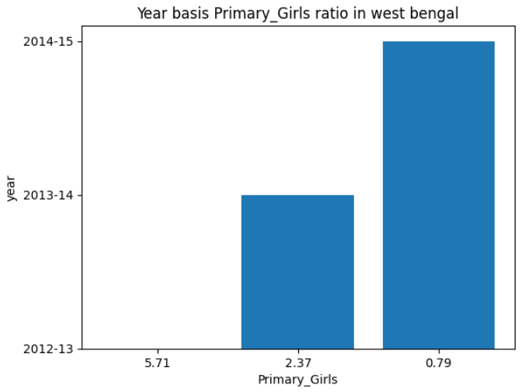
Q.1 What is the ratio of primary girls in west bengal by year basis
The ratio of primary girls shows a fluctuating trend over the years, with a slight decrease in 2013-14. Overall, the ratio remains relatively stable.

Slide 6
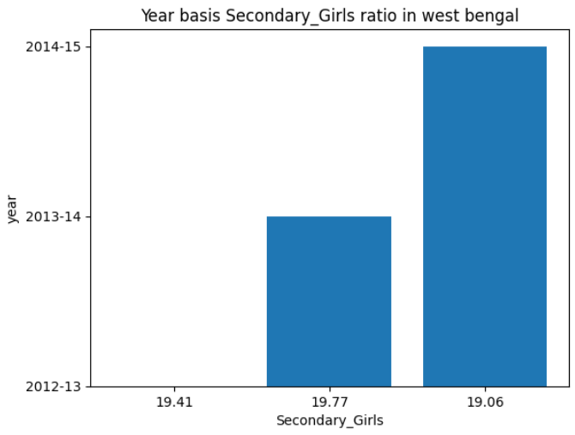
Q.2 What is the ratio of secondary girls in west bengal by year basis
The ratio of secondary girls exhibits a similar pattern to primary girls, with fluctuations and a slight dip in 2013-14. However, the overall trend suggests a gradual increase in the ratio.

Slide 7

Q.3 What is the ratio of primary boys in west bengal by year basis
The ratio of primary boys also fluctuates over the years, with a noticeable increase in 2013-14. The overall trend indicates a relatively stable ratio.

Slide 8

Q.4 What is the ratio of secondary boys in west bengal by year basis
Similar to primary boys, the ratio of secondary boys fluctuates but shows a slight increase in 2013-14. The overall trend suggests a gradual increase in the ratio.

Slide 9

Q.5 What is the ratio of upper primary boys in west bengal by year basis
The ratio of upper primary boys demonstrates a fluctuating pattern, with a noticeable dip in 2013-14. Despite the fluctuations, there is an overall slight increasing trend in the ratio, indicating potential improvements in access to upper primary education for boys in West Bengal.

Slide 10

Q.6 What is the ratio of upper primary girls in west bengal by year basis
The ratio of upper primary girls demonstrates a fluctuating pattern, with a slight decrease in 2013-14. The overall trend suggests a relatively stable ratio.

Slide 11

Conclusion
Progress in Enrollment: India has made significant strides in increasing enrollment rates at various education levels.
Gender Disparities: Gender gaps in education might persist, with lower enrollment or higher dropout rates for girls in certain regions.
Regional Variations: Significant differences in education indicators may exist across states or regions, highlighting the need for targeted interventions.
Literacy Rate Trends: Literacy rates have generally been improving, but further efforts are required to achieve universal literacy.
Quality of Education: Focus on improving the quality of education, including teacher training, infrastructure, and curriculum, remains crucial.
Impact of Socioeconomic Factors: Socioeconomic background can significantly influence education access and outcomes, requiring initiatives to address disparities.

Slide 12

THANK YOU

